Slide 1

MOTION PLANNING FOR A DUBIN’S CAR USING RRT
Team
Ashit Mohanty
Huzefa Shabbir Hussain Kagalwala
Rakshitaa Geetha Mohan
Rahil Paresh Modi
CPSC 8810
FINAL PROJECT

Slide 2


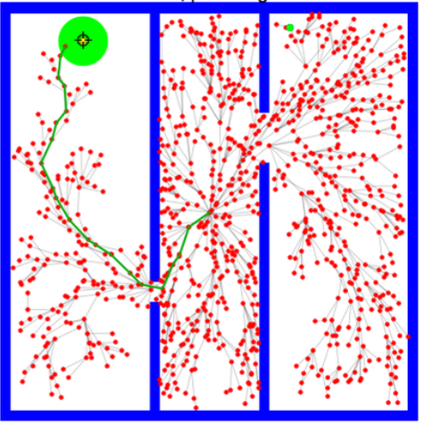
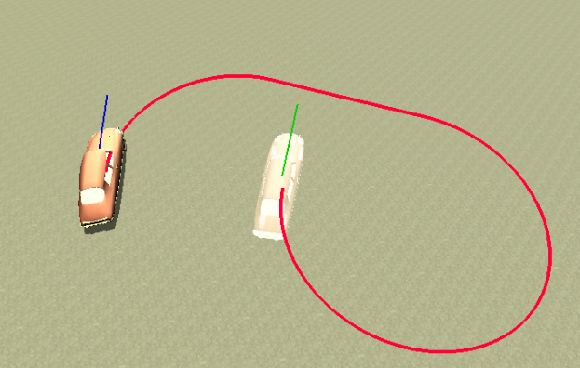
INTRODUCTION
PROBLEM STATEMENT:
The project deals with implementing RRT (Rapidly-exploring Random Tree) algorithm for planning the path of a non-holonomic car (Dubin’s car model) to move from initial state to goal state.
+
RRT
Dubin's car

Slide 3
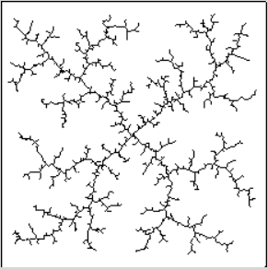
RAPIDLY EXPLORING RANDOM TREE
Developed by Steven.M.Lavalle and James.F.Kuffner Jr.
It is a path finding algorithm which searches the available space by building a tree using randomly sampled points. It is inclined towards large unsearched areas of the problem.
It is used to generate open loop trajectories for systems with state-constraints
These algorithms can handle multi-dimensional spaces (up to twelve degrees of freedom) with multiple queries and obstacles.
RRT algorithm does not return the optimal path as it chooses a random node to build the tree. RRT* algorithm was developed to do away with this shortcoming of RRT.

Slide 4
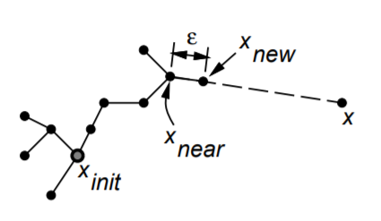
RRT : DEFINITION
The basic idea is to explore the unexplored regions of the space incrementally and building the search tree towards it.
From the initial state, a vertex is randomly sampled in the free space as shown.
The nearest node to the new random node is chosen from the RRT available at that time. The new vertex is added to the RRT based on the set of state constraints, U.
The distance between the tree and the random state is decided by a factor. If the random state is present at a large distance from the nearest state, another vertex is generated at a maximum distance from the nearest node in the tree along the line to the random sample.
The random samples decide the direction of the tree growth while the growth factor determines its rate.

Slide 5
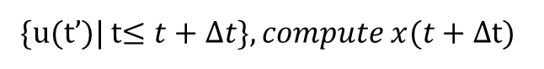
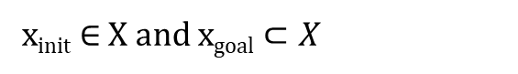
RRT: PROBLEM FORMULATION
1.State space: A topological space, X. This has all the configurations/state possible in the available space.
2. Boundary values: This defines the initial and goal configurations inside the free space, X.
x_{init} $∈$ X and x_{goal} $⊂X$
3.Collision Detector: This is a function that is used to determine whether the randomly sampled node lies within the obstacle or not. It also checks whether the added vertex passes through an obstacle or not. This could be a binary-valued function.
4. Inputs: This specifies the allowable set of actions that can affect the state. In this case, we have Dubin’s car model which has only a set of actions that can be performed at an instant.
5. Incremental Simulator: This function gives the state after applying the input to the current state over a time interval.
{u(t’)| t$≤t+Δt\}, compute x(t+Δ$t)
6.Metric : A real valued function which determines the distance between the given pairs of points in X.

Slide 6
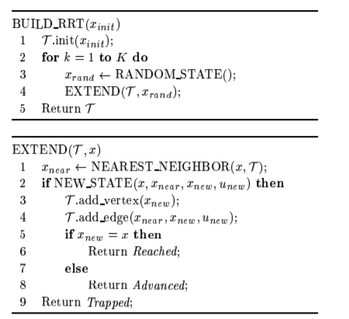
RRT: CONSTRUCTION ALGORITHM
In the build phase, the initial state is first added to the tree.
The random nodes are generated.
In the extend phase, the nearest node (from RRT) to the random node generated is found. The new node is generated by propagating the neighbour node along the direction of random node by a set distance.
The new node is added to the tree after checking for collision.
If the new node added is the goal node, then the RRT stops building.

Slide 7
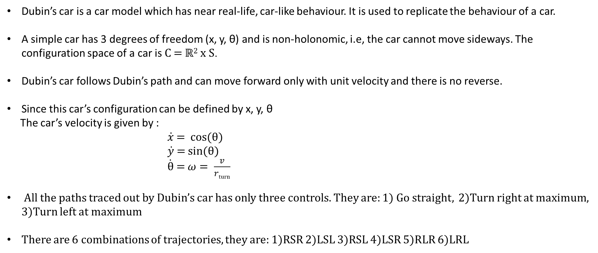
DUBIN’S CAR MODEL
Dubin’s car is a car model which has near real-life, car-like behaviour. It is used to replicate the behaviour of a car.
A simple car has 3 degrees of freedom (x, y, θ) and is non-holonomic, i.e, the car cannot move sideways. The configuration space of a car is C = ℝ² x S.
Dubin’s car follows Dubin’s path and can move forward only with unit velocity and there is no reverse.
Since this car’s configuration can be defined by x, y, θ
The car’s velocity is given by :
$\dot{x}$ = cos(θ)
$\dot{y}$ = sin(θ)
$\dot{\text{θ}}$ = $ω= \frac{v}{rturn}$
All the paths traced out by Dubin’s car has only three controls. They are: 1) Go straight, 2)Turn right at maximum, 3)Turn left at maximum
There are 6 combinations of trajectories, they are: 1)RSR 2)LSL 3)RSL 4)LSR 5)RLR 6)LRL

Slide 8
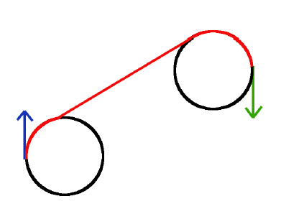
DUBIN’S CURVES : DESCRIPTION
For CSC Trajectories : RSR, LSL, RSL, LSR
From the initial and goal state, two circles of radius r (minimum radius the car can turn) are drawn as shown.
Tangents are drawn from these circles connecting the initial and final state.
The car moves along the circle and the straight line to execute RSR control.
There are four possible tangent lines for each pair of circles but only one of them valid for each case.
To get the correct trajectory we need to get the tangents correctly.
RLR and LRL are controls that will not be used in any case as they are
not optimal.

Slide 9
DUBIN’S PATH : FORMULATION
The center of the circles: The center of the starting point and the goal point must be calculated
Tangent points and angles : The tangents that represent the straight part connecting the two curves must be calculated. The angles at which these tangents must be drawn should also be calculated
Distance between two circles: The distance between the center of the circles is required
Arc lengths : The arc length of the curves is required to be calculated .

Slide 10
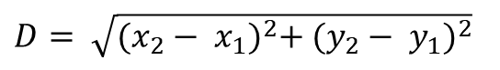
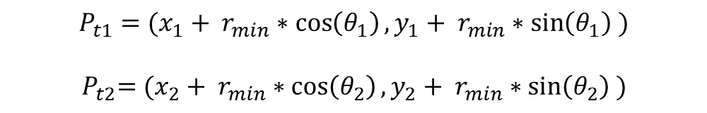
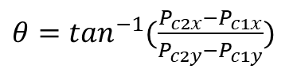
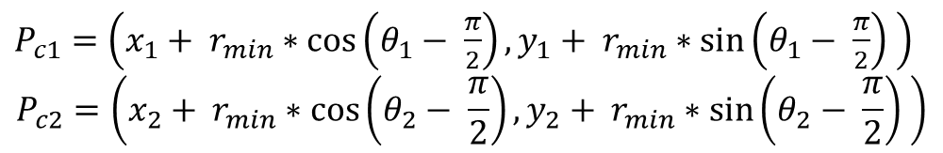
DUBIN’S PATH : GENERATION
The start and endpoint are taken as the center points of the circle and the minimum turning radius is taken as the radius of these circles.
$P_{c1}=\left(x_{1}+ r_{min}∗\cos\left(θ_{1}− \frac{π}{2}\right),y_{1}+ r_{min}∗\sin\left(θ_{1}− \frac{π}{2}\right) \right)$
$$P_{c2}=\left(x_{2}+ r_{min}∗\cos\left(θ_{2}− \frac{π}{2}\right),y_{2}+ r_{min}∗\sin\left(θ_{2}− \frac{π}{2}\right) \right)$$
Then, the tangent points and the theta at which these points must be connected is calculated as shown below:
$θ=\tan^{−1}(\frac{P_{c2x}−P_{c1x}}{P_{c2y}−P_{c1y}})$
$$P_{t1}=(x_{1}+ r_{min}∗\cos\left(θ_{1}\right),y_{1}+ r_{min}∗\sin\left(θ_{1}\right) )$$
${ P}_{t2}=(x_{2}+ r_{min}∗\cos\left(θ_{2}\right),y_{2}+ r_{min}∗\sin\left(θ_{2}\right) )$
The distance between the centre of the circles are calculated using:
$D= \sqrt{{(x_{2}− x_{1})}^{2}+ {(y_{2}− y_{1})}^{2}}$

Slide 11
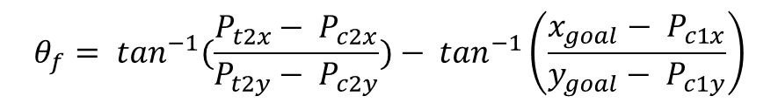
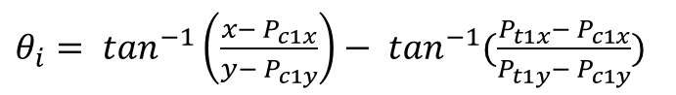
DUBIN’S PATH : GENERATION
The arc lengths of the circle to be drawn has to be computed. These are computed using the angles of the arcs. These angles are computed by the following equation.
$θ_{i}= \tan^{−1}\left(\frac{x− P_{c1x}}{y− P_{c1y}}\right)− \tan^{−1}(\frac{P_{t1x}− P_{c1x}}{P_{t1y}− P_{c1y}})$
$$θ_{f}= \tan^{−1}(\frac{P_{t2x}− P_{c2x}}{P_{t2y}− P_{c2y}})− \tan^{−1}\left(\frac{x_{goal}− P_{c1x}}{y_{goal}− P_{c1y}}\right)$$

Slide 12
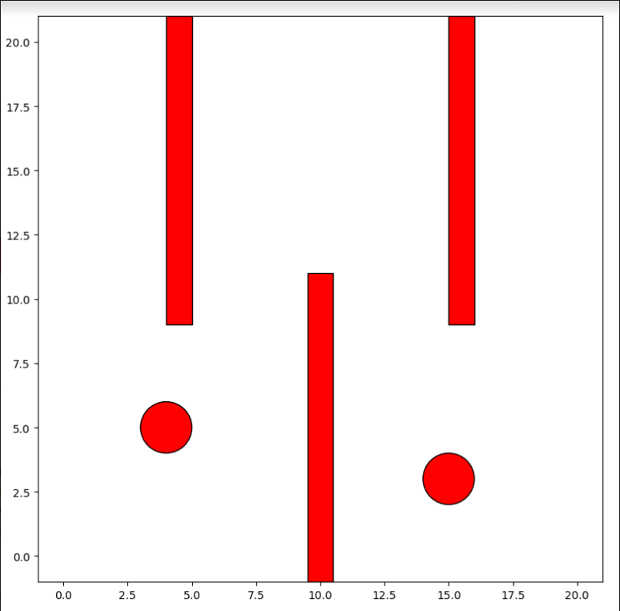
ENVIRONMENT
Matplotlib library is imported for creating the graphical environment
An environment of the dimensions, 20 x 20 was created
The environment gets refreshed at 100Hz
Three alternating rectangular boxes and 2 circular obstacles were added in the environment
The start and goal configurations are received from the user and checked for collision. If the point lies within the obstacle space, the user is asked to input the configurations again.

Slide 13
CODE IMPLEMENTATION
The start node gets added to the tree initially.
After the random vertex is generated, the nearest node (from the tree) is found.
The nearest node is propagated along the direction of the random node by a growth factor/step distance (in this case, 1) and this becomes the new node.
The path to reach the new node from its parent is found by using one of the four Dubin’s curves (LSL, RSR,LSR,RSL). The trajectory that gives minimum distance is taken as the ideal path.
The new node is checked for collision. If it lies in the collision-free space, then the node is added to the tree. This way, the RRT gets propagated until the new node is within a set distance of the goal node.
A separate variable in the node class is used to store the index of the parent.
The same process is repeated for connecting the goal node to the start node. The paths are connected by tracing the parent of the child node.

Slide 14
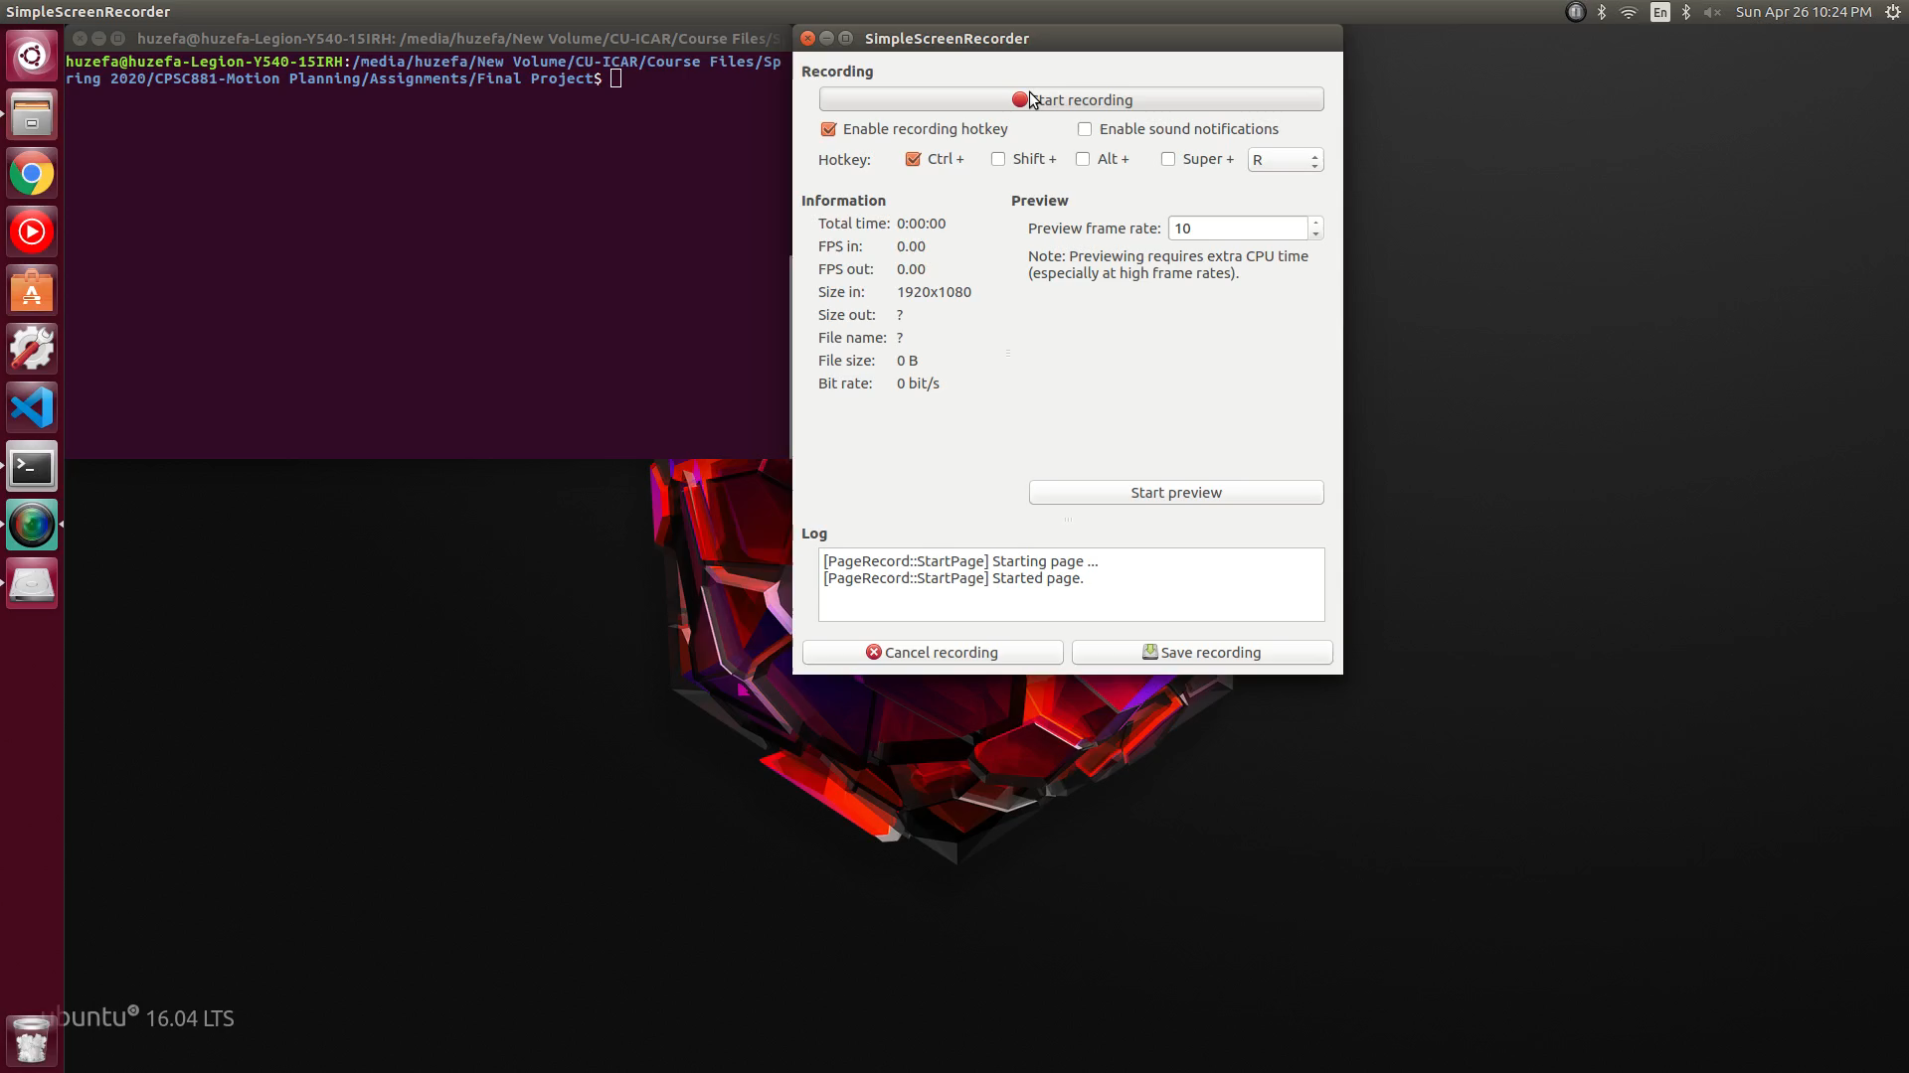
DEMONSTRATION -1

Slide 15
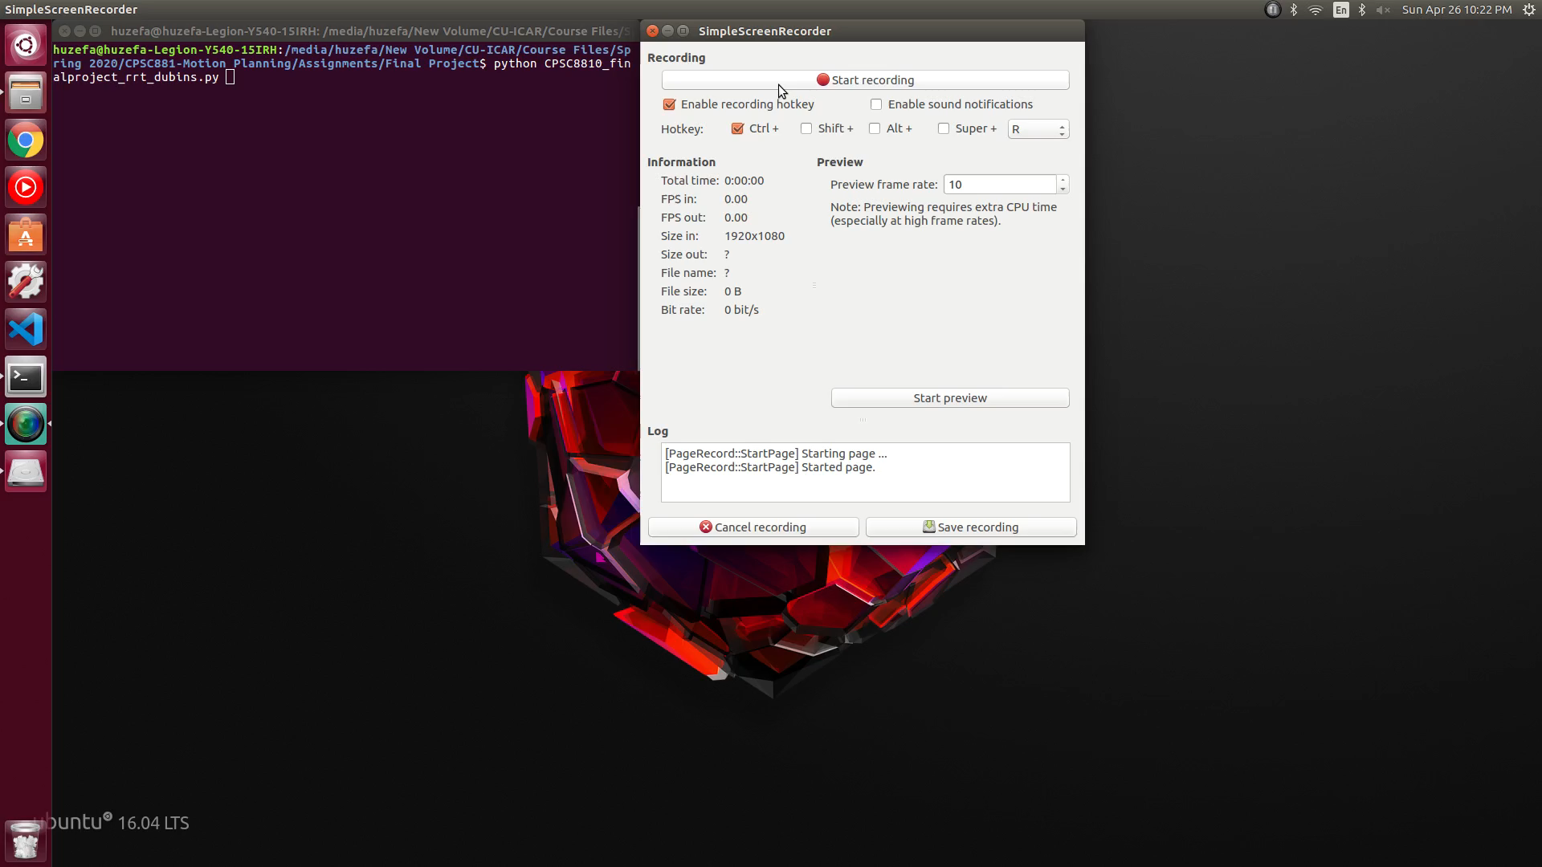
DEMONSTRATION - 2

Slide 16
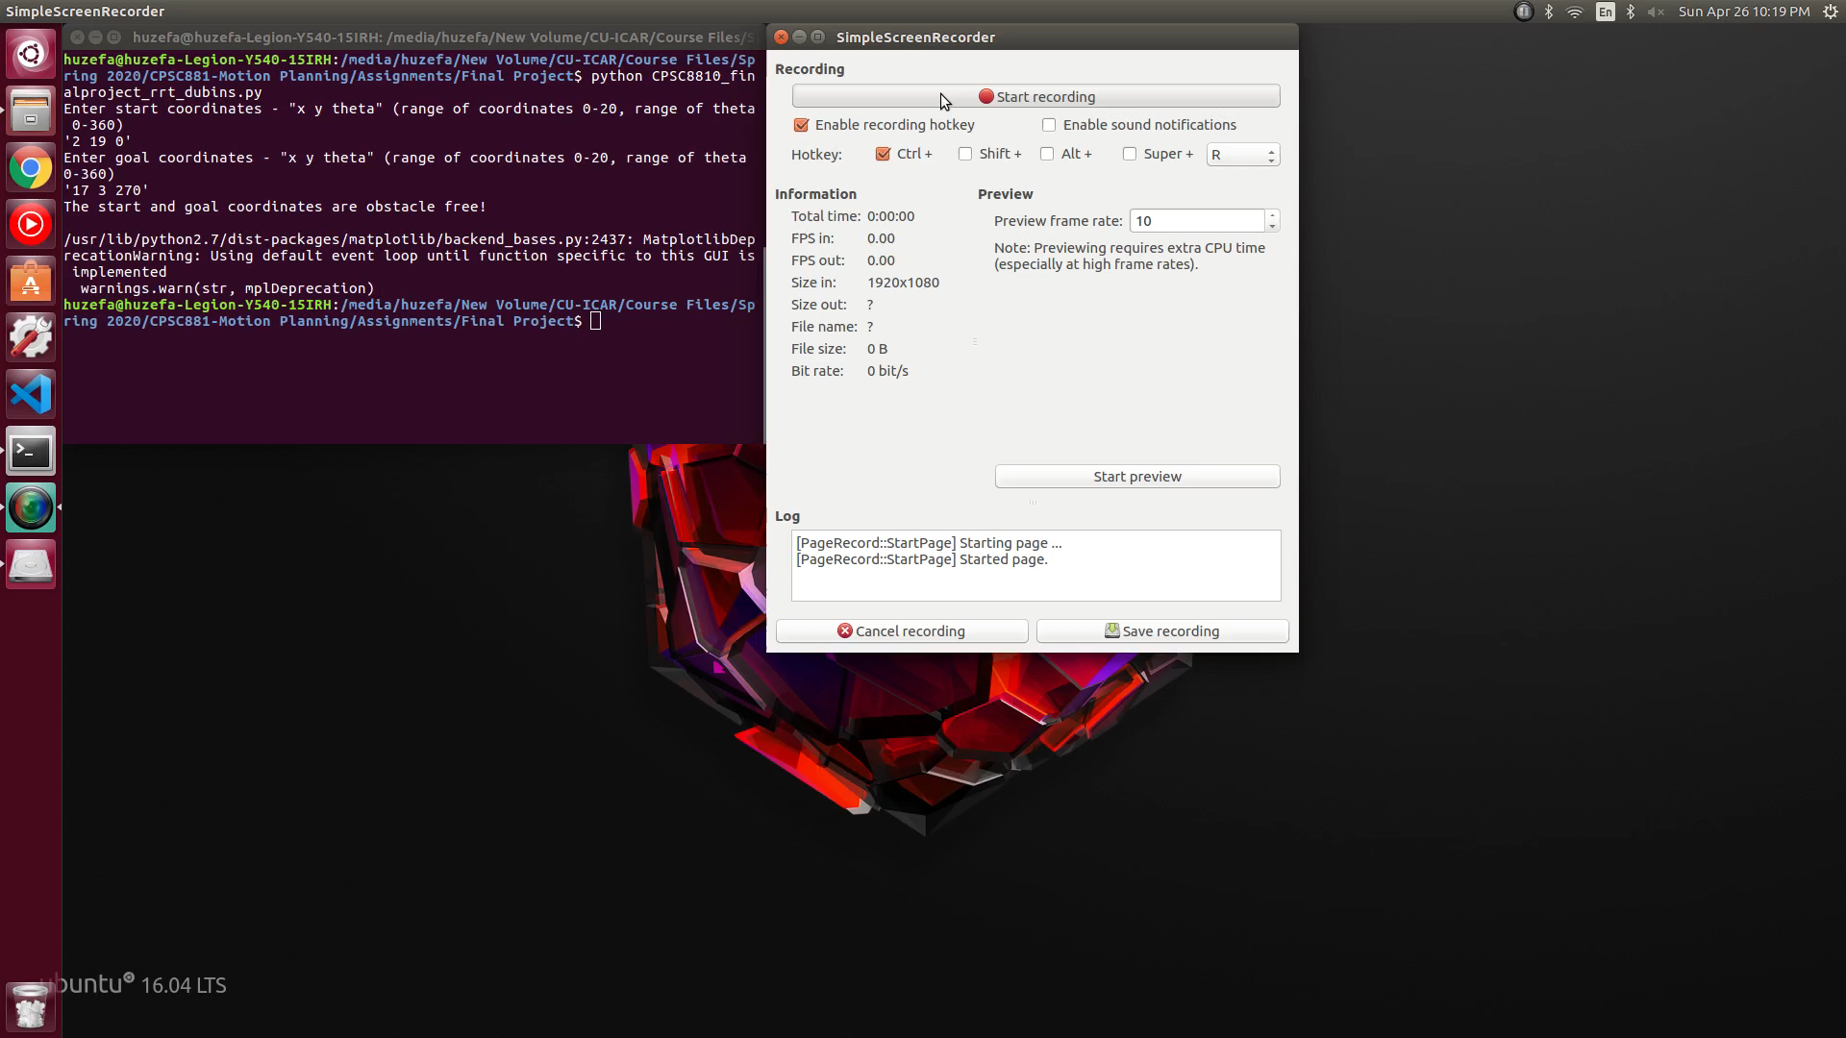
DEMONSTRATION - 3

Slide 17
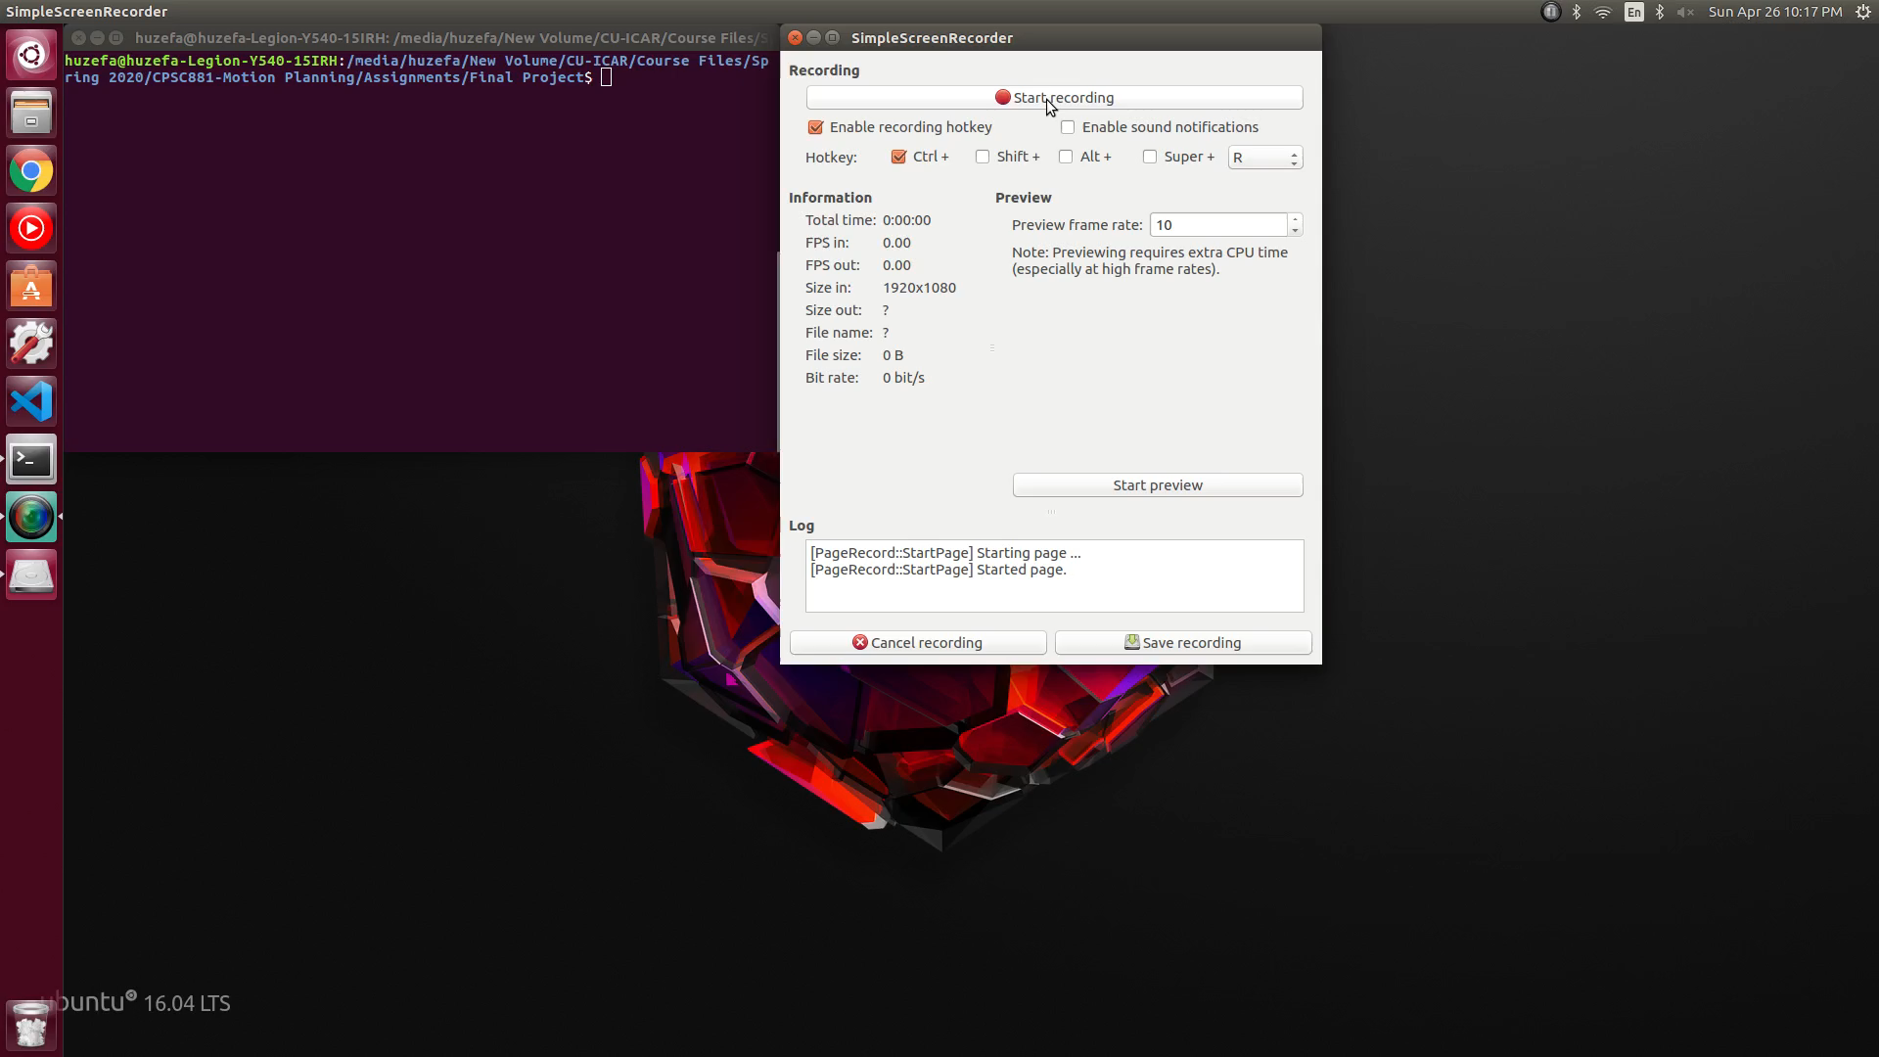
DEMONSTRATION - 4

Slide 18
REFERENCES
[1] S. M. L. Valle, "Rapidly-Exploring Random Trees: A New Tool for Path Planning," [Online]. Available: http://msl.cs.illinois.edu/~lavalle/papers/Lav98c.pdf.
[2] https://en.wikipedia.org/wiki/Rapidly-exploring_random_tree
[3] http://planning.cs.uiuc.edu/node658.html
[4] A. Giese, "A Comprehensive, Step-by-Step Tutorial on," [Online]. Available: https://gieseanw.wordpress.com/2012/10/21/a-comprehensive-step-by-step-tutorial-to-computing-dubins-paths/.

